Slide 1


<Name>
<Date>

Slide 2

Outline
Executive Summary
Introduction
Methodology
Results
Conclusion
Appendix

Slide 3
Executive Summary
Summary of methodologies
Data collection via API
Data collection by web scraping
Exploratory data analysis using SQL
Exploratory data analysis with data visualization
Interactive maps with Folium
Machine learning predictions
Summary of all results
Results of exploratory data analysis
Machine learning model predictions

Slide 4
Introduction
Project background and context
SpaceX advertises Falcon 9 rocket launches with a cost of 62 millions dollars unlike other providers who cost upwards of 165 million each. Much of these savings are because SpaceX can reuse the first stage. So the aim of the project was to analyze SpaceX data and determine whether the first stage will land successfully or not so that we can determine the cost of each launch.
Problems you want to find answers
What features are needed to determine if a launch will be successful or not
What conditions are needed to ensure a successful landing

Slide 5

Section 1

Slide 6
Methodology
Data collection methodology:
Data was collected using SpaceX API and webscraping from Wikipedia
Perform data wrangling
One hot encoding was applied, data was cleaned using Pandas library
Perform exploratory data analysis (EDA) using visualization and SQL
Perform interactive visual analytics using Folium and Plotly Dash
Perform predictive analysis using classification models
Different models like KNN, SVM were used and accuracy was compared

Slide 7
Data Collection
Data was collected using requests library on the SpaceX API.
We read the response content as a JSON file and converted it to a dataframe using .json_normalize().
We also performed webscraping on a Wikipedia page about Falcon 9 landings using the BeautifulSoup library.
We parsed the HTML content, read table contents, and converted it to a dataframe for future use.

Slide 8
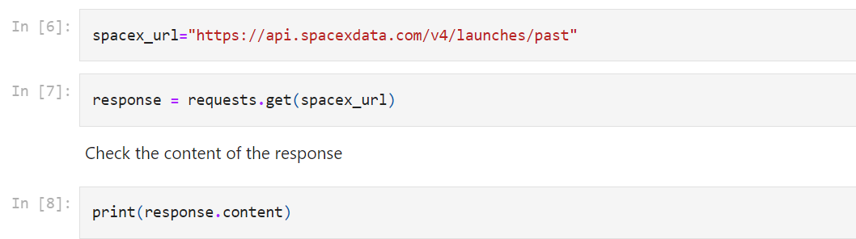
Data Collection – SpaceX API
Present your data collection with SpaceX REST calls using key phrases and flowcharts
https://github.com/saniyavijayvargiya/ibm-assignments/blob/main/Data%20Collection%20API.ipynb
Place your flowchart of SpaceX API calls here

Slide 9
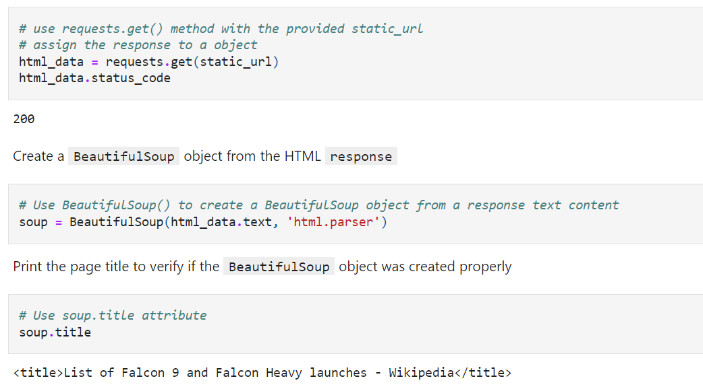
Data Collection - Scraping
Present your web scraping process using key phrases and flowcharts
https://github.com/saniyavijayvargiya/ibm-assignments/blob/main/Data%20Collection%20API.ipynb
Place your flowchart of web scraping here

Slide 10
Data Wrangling
The data was cleaned by removing null or invalid values, formatting the data for consistency, and columns were adjusted.
We performed exploratory data analysis using pandas functions and determined the features important for training.
We calculated the number of launches at each site and the number of each orbits by using groupby function on rows.
We created a landing outcome column.
https://github.com/saniyavijayvargiya/ibm-assignments/blob/main/Data%20Wrangling.ipynb

Slide 11
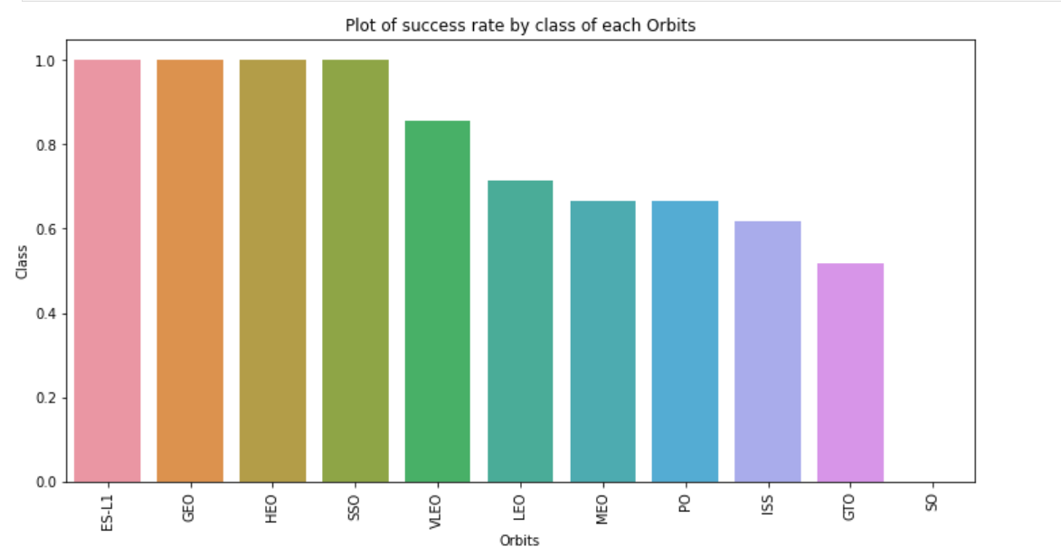
EDA with Data Visualization
We visualised the relationship between several features including flight number vs launch site, payload vs launch site, success rate vs orbit, flight number vs orbit, etc.

Slide 12
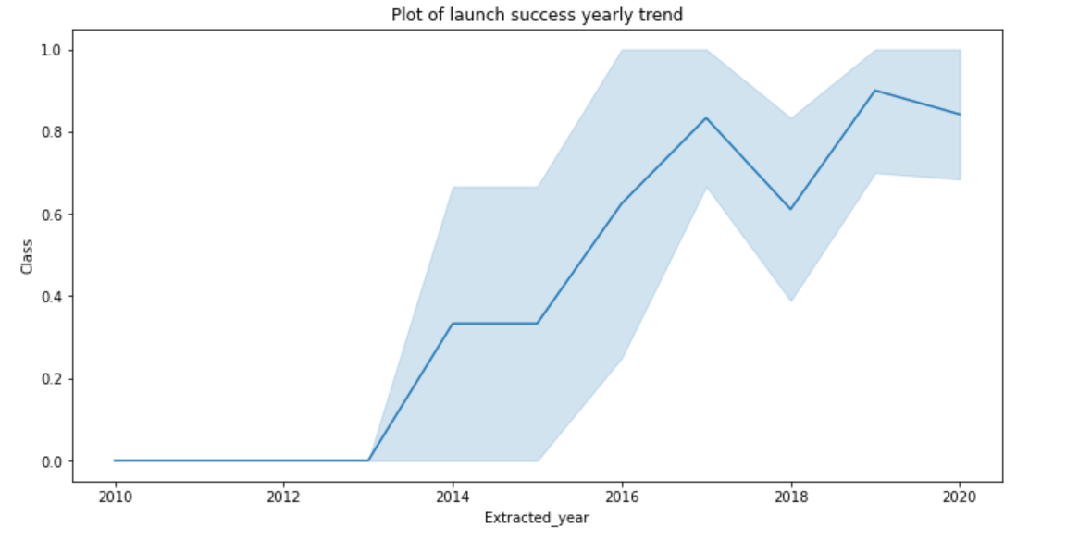
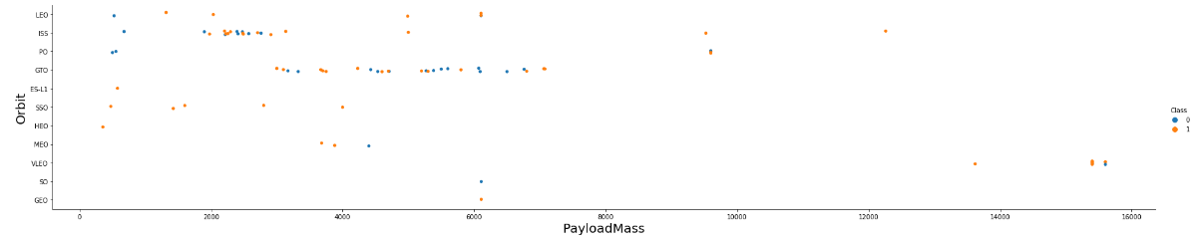
https://github.com/saniyavijayvargiya/ibm-assignments/blob/main/EDA%20with%20Data%20Visualization.ipynb

Slide 13
EDA with SQL
We loaded the data into a database and established a connection. Then we wrote queries using magic SQL for-
Finding unique launch sites in the data
Finding total payload mass carried by NASA (CRS)
Finding the dates when successful landing on ground pads was achieved
Finding names of the boosters with weight within particular range which have success in drone ship
Listing total number of successes and failures
https://github.com/saniyavijayvargiya/ibm-assignments/blob/main/EDA%20with%20SQL.ipynb

Slide 14
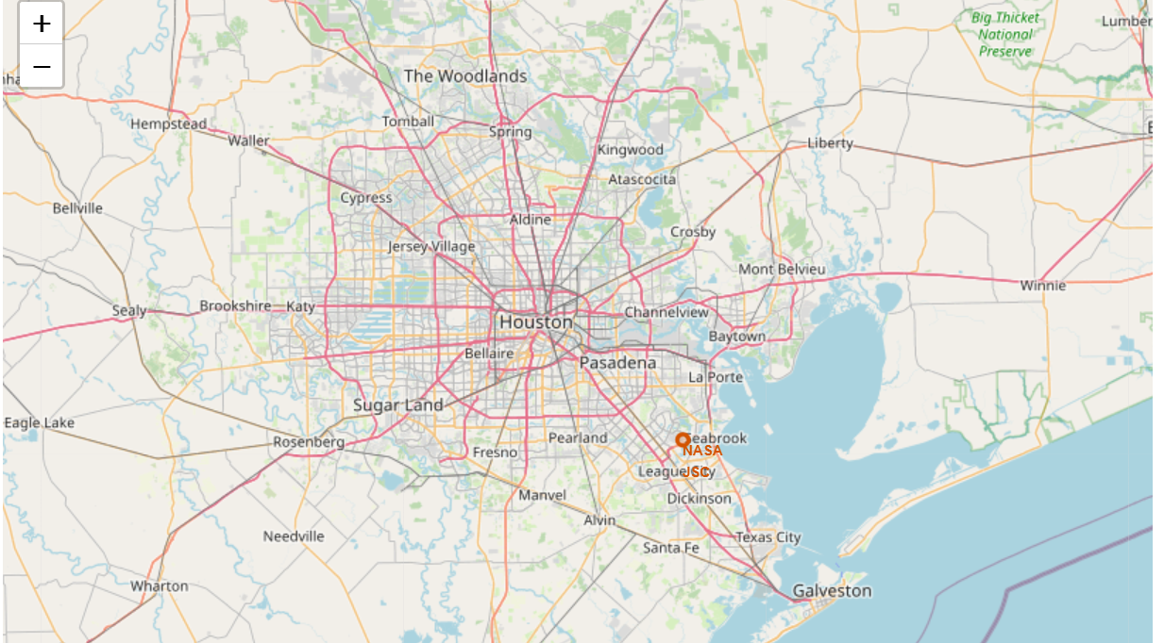
Build an Interactive Map with Folium

Slide 15
Predictive Analysis (Classification)
The data was split into training and testing sets after cleaning and analysis.
We tuned the hyperparameters using GridSearchCV.
Using different models such as KNN, SVM, logistic regression, etc. , the rate of accuracy was determined for every one of them so we can decide which one performs the best.
https://github.com/saniyavijayvargiya/ibm-assignments/blob/main/Machine%20Learning%20Prediction.ipynb

Slide 16

Section 2

Slide 17
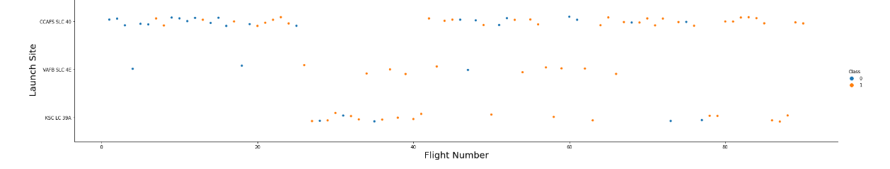
Flight Number vs. Launch Site
Show a scatter plot of Flight Number vs. Launch Site

Slide 18
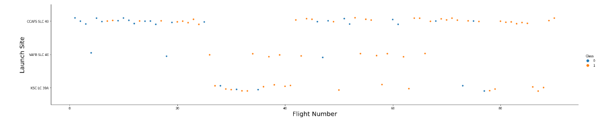
Payload vs. Launch Site
Show a scatter plot of Payload vs. Launch Site

Slide 19
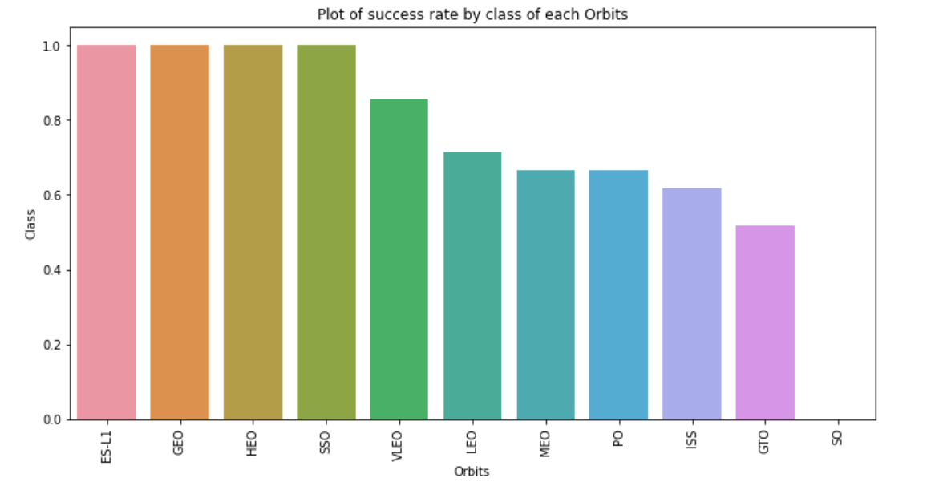
Success Rate vs. Orbit Type
Show a bar chart for the success rate of each orbit type

Slide 20
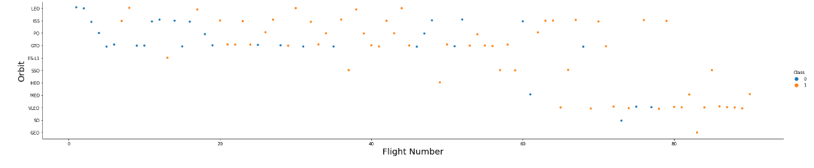
Flight Number vs. Orbit Type
Show a scatter point of Flight number vs. Orbit type

Slide 21
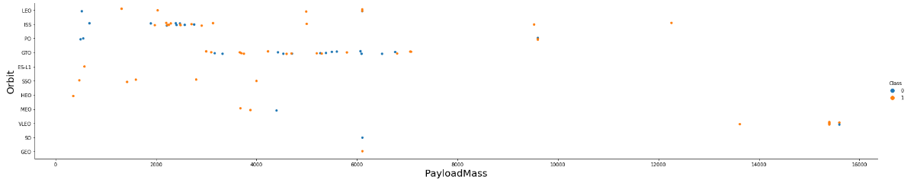
Payload vs. Orbit Type
Show a scatter point of payload vs. orbit type

Slide 22
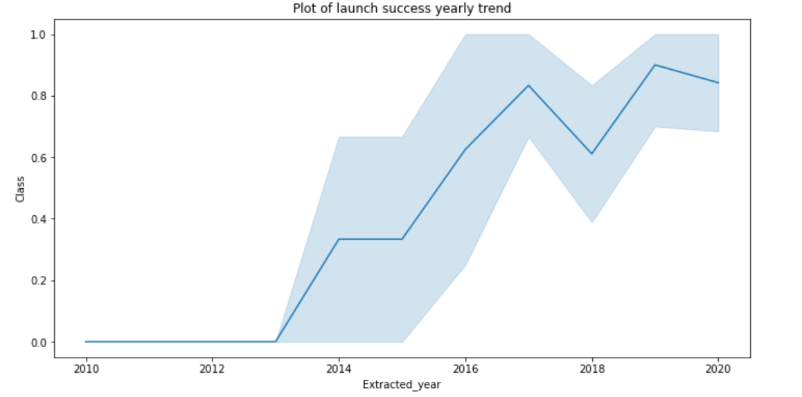
Launch Success Yearly Trend
Show a line chart of yearly average success rate

Slide 23
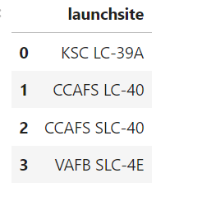
All Launch Site Names
Find the names of the unique launch sites

Slide 24
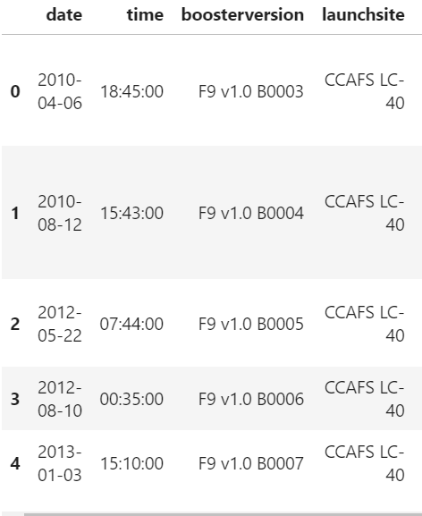
Launch Site Names Begin with 'CCA'

Slide 25

Total Payload Mass
Calculate the total payload carried by boosters from NASA

Slide 26
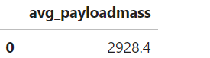
Average Payload Mass by F9 v1.1

Slide 27
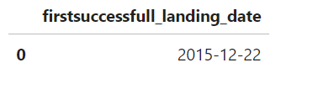
First Successful Ground Landing Date
Find the dates of the first successful landing outcome on ground pad

Slide 28
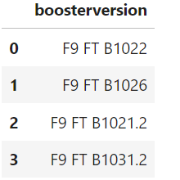
Successful Drone Ship Landing with Payload between 4000 and 6000

Slide 29
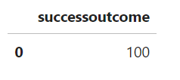
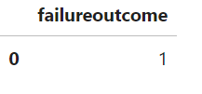
Total Number of Successful and Failure Mission Outcomes

Slide 30
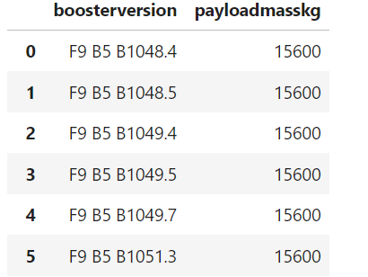
Boosters Carried Maximum Payload

Slide 31
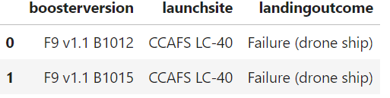
2015 Launch Records

Slide 32
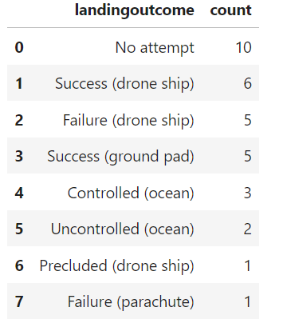
Rank Landing Outcomes Between 2010-06-04 and 2017-03-20

Slide 33

Section 3

Slide 34
<Folium Map Screenshot 1>

Slide 35

Section 5

Slide 36
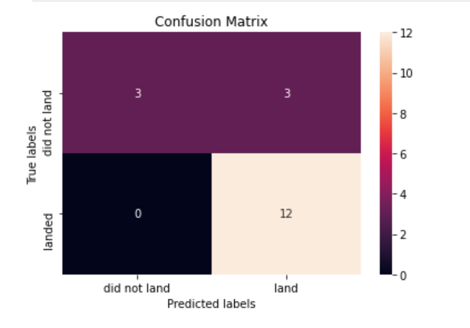
Confusion Matrix
Best accuracy shown was 83.33

Slide 37
Conclusions
Launch success rate started to increase after 2013 till 2020.
Orbits ES-L1, GEO, HEO, VLEO, SSO had the most success rate.
KSC LC-39A had the most successful launches of any launch site.
The decision tree classifier is the best machine learning algorithm for this task.

Slide 38


